Slide 1
JavaBeans JSP Standard Actions Dispatching Mechanisms Expression Language JSPs in XML #StandardAction #EL #MVC1

Slide 2
Objectives
How to build the Web Application using MVC1?
Standard Actions
Dispatching Mechanisms
How to remove the scripting element (Java Code) in the jsp (view)?
Expression Language

Slide 3
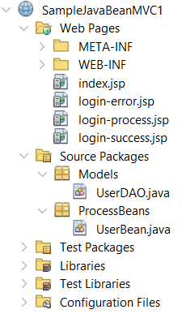
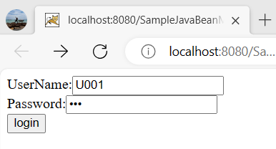
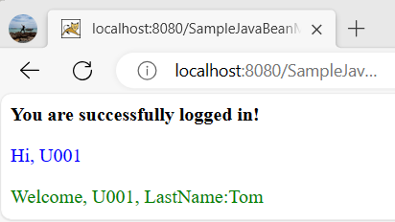
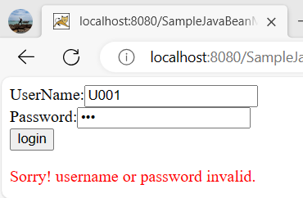
MVC 1 Requirements
Building the web application with authentication functions
The GUI is shown as

Slide 4
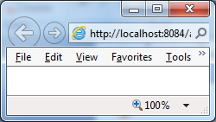
MVC1 Interactive Server Model
1. Send request
Web/App Server
JSP
1. Click Login
4. Response the result page
2. Check Login
Java Beans/BLO
Welcome page/ invalid page
3. Call
4. Query DB
DAO
DB
Client
Server

Slide 5
JSP Standard Actions Java Beans
JavaBeans technology is the component architecture for the Java 2 Platform, Standard Edition (J2SE).
JavaBeans technology is based on the JavaBeans specification.
Components (JavaBeans) are reusable software programs that you can develop and assemble easily to create sophisticated applications.
Are reusable components which define the interactivity of Java objects
Are reusable software components that work independently on a workstation and with a set of other distributed components.
Encapsulate state and behavior of software component
The different point between Java Bean and Java class
Java Bean implemented from Serializable
The process of create a copy of an object suitable for passing to another object/ package classes into streams of bytes that are transmitted through networks or saved to the disk

Slide 6
JSP Standard Actions Java Beans
In order to function as a JavaBean class, an object class must obey certain conventions about method naming, construction, and behavior.
These conventions make it possible to have tools that can use, reuse, replace, and connect JavaBeans.
A Bean a simple Java Class that follows certain coding conventions
Bean class should always use a package name
Bean class must have a public no-argument constructor
The properties of bean (persistence) is not declared “public”. They are accessed through getter and setter methods.
Public getter method is used to retrieve the properties of a bean class
Public setter method is used to set the properties of a bean class
Notes:
The first character of each property should name in lower case then the accessor methods are used along with property name with the first character of each word in upper case (Ex: length – getLength and setLength)
The dataType of properties is boolean then the getter method is isXxx instead of getXxx

Slide 7
JSP Standard Actions Java Beans
A JSP page accesses Java Beans using tag action and gets the result of processing without how to JavaBeans implementation and process
Java Bean tags are combined with JSP elements
Java Bean tags are translated into single java Servlet classes on the server
JSP technology directly supports using JavaBeans components with JSP language elements

Slide 8
JSP Standard Actions Standard Actions
An alternative to inserting java code into designed presentation page
Are performed when a browser requests for a JSP page
Are used for
Forwarding requests and performing includes in page
Embedding the appropriate HTML on pages
Interacting between pages and JavaBeans
Providing additional functionality to tag libraries
Syntax: <prefix:actionName att=“…”>...</prefix:actionName>
Some properties
It use “jsp” prefix
The attributes are case sensitive
Value in the attributes must be enclosed in double quotes
Standard actions can be either an empty or a container tag
A JSP provides 03 tags that use interact with JavaBean
jsp:useBean, jsp:setProperty, jsp:getProperty

Slide 9
JSP Standard Actions The <jsp:useBean> tag
Is used to locate or instantiate a JavaBeans component
First tries to locate an instance of the Bean otherwise it instantiates the Bean from a class
To locate or instantiate the Bean, the <jsp:useBean> follows the following steps:
Attempts to locate a Bean (means attribute containing object) within the scope
Defines an object reference variable with the name
Stores a reference to it in the variable, if it retrieves the Bean
Instantiates it from the specified class, if it cannot retrieve the Bean
Syntax
<jsp:useBean id=“<identifier>” class=“<class name>” [scope = “scope name”]/>
id: is used to name the attribute name, to refer to the Bean instance in specify scope
class: a class name implementing a Bean processing.
scope: the lifespan of a bean (sharable). Default value is page
Notes:
+scope: represents the scope of the bean. It may be page, request, session or application. The default scope is page.
page: specifies that you can use this bean within the JSP page. The default scope is page.
request: specifies that you can use this bean from any JSP page that processes the same request. It has wider scope than page.
session: specifies that you can use this bean from any JSP page in the same session whether processes the same request or not. It has wider scope than request.
application: specifies that you can use this bean from any JSP page in the same application. It has wider scope than session.

Slide 10
JSP Standard Actions The <jsp:useBean> tag
Use scriptlet element to declare Java Bean:
<%
className id = (className) scope.getAttribute(“identifier”);
if (id == null) {
id = new className();
scope.setAttribute (“identifier”, id);
}
%>
Ex
<jsp:useBean id=“book1” class=“store.book”/>
similar to
<%
store.book book1 = (store.book) pageContext.getAttribute(“book1”); if (book1 == null) { book1 = new store.book(); pageContext.setAttribute(“book1”, book1);
}
%>

Slide 11
JSP Standard Actions The <jsp:useBean> tag
Casting
<jsp:useBean id=“<identifier>” class=“<class name>” type = “<dataType>” [scope = “scope type”]/>
type: Java – DataType
JSP Scriptlet element
<%
dataType id = (dataType) scope.getAttribute(“identifier”);
if (id == null) {
id = (dataType) (new className());
scope.setAttribute (“identifier”, id);
}
%>
Ex
<jsp:useBean id=“book1” class=“store.book” type=“library.magazine” />
Similar to
<% library.magazine book1 = (library.magazine) pageContext.getAttribute(“book1”); if (book1 == null) { book1 = (library.magazine) (new store.book()); pageContext.setAttribute(“book1”, book1);
} %>

Slide 12
JSP Standard Actions The <jsp:useBean> tag
Other syntax
<jsp:useBean …> statement </jsp:useBean>
Ex
<jsp:useBean id="count" class="ABean.AccessBean" scope="application">
<jsp:setProperty name="count" property="firstPage" value="ATest.jsp" />
</jsp:useBean>
Notes:
If using some specified symbol in command, the symbol “\” should put such as
‘ (\’) , “ (\”), \ (\\), % (\%), ...
The JSP scriptlets use id as a variable.

Slide 13
JSP Standard Actions The <jsp:getProperty> tag
Retrieves a bean property value using the getter methods and displays the output in a JSP page
Before using <jsp:getProperty> you must create or locate a bean with <jsp:useBean>
Drawback
Fails to retrieve the values of an indexed property
Fails to directly access enterprise beans components
Syntax
<jsp:getProperty name=“<identifier>” property=“<attr name>” />
name: the identifier declared in jsp:useBean
property: the property name is implemented in Java Bean
Use scriptlet command
<%= <identifier>.getXxx() %>
Ex
<jsp:getProperty name=“book1” property=“title”/>
Similar to <%= book1.getTitle()%>

Slide 14
JSP Standard Actions The <jsp:setProperty> tag
Sets the value of the properties in a bean, using the bean’s setter methods
Before using <jsp:setProperty> you must create or locate a bean with <jsp:useBean>
Syntax
<jsp:setProperty name=“<identifiers>” property= “<attr name>” value=“<const/ expression>” />
Use scriptlet command:
<%
id.setXxx(<value>);
scope.setAttribute(“identifier”, id);
%>
Ex: <jsp:setProperty name=“book1” property=“title” value=“JSP Book” />
Similar to <% book1.setTitle(“JSP Book”); pageContext.setAttribute(“book1”, book1); %>

Slide 15
JSP Standard Actions The <jsp:setProperty> tag
Assign a expression to action setProperty
String sMsg = request.getParameter("sms");
<jsp:setProperty name="msg" property="message" value="<%= sMsg %>" />
Use param properties in setProperty: receive an inputted value from a request (from other JSP page, application, or URL)
<jsp:setProperty name="msg" property="message" param=“message” />
To set values to whole bean properties, the symbol “*” is assigned to setProperty
<jsp:setProperty name="msg" property=“*" />
Notes:
The Bean Action is executed only if all of properties is assigned values because the engine does not assign a null value with lacked properties.
In some web server, the exceptions are thrown if a property value is assigned to double
The converted mechanism does not ensure a valid value for property (instead of manual casting)
The parameters name should similar to properties name implemented in Bean

Slide 16
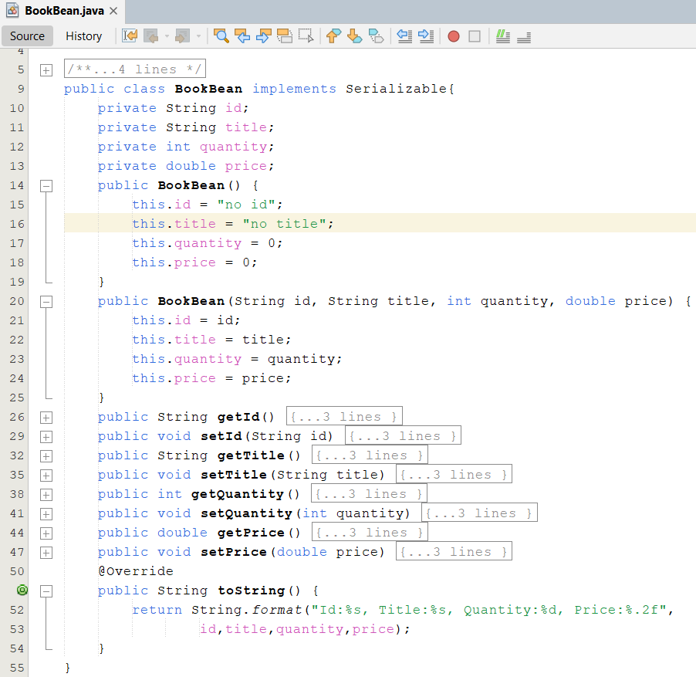
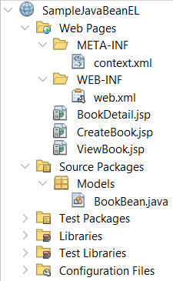
Demo 01
1

Slide 17
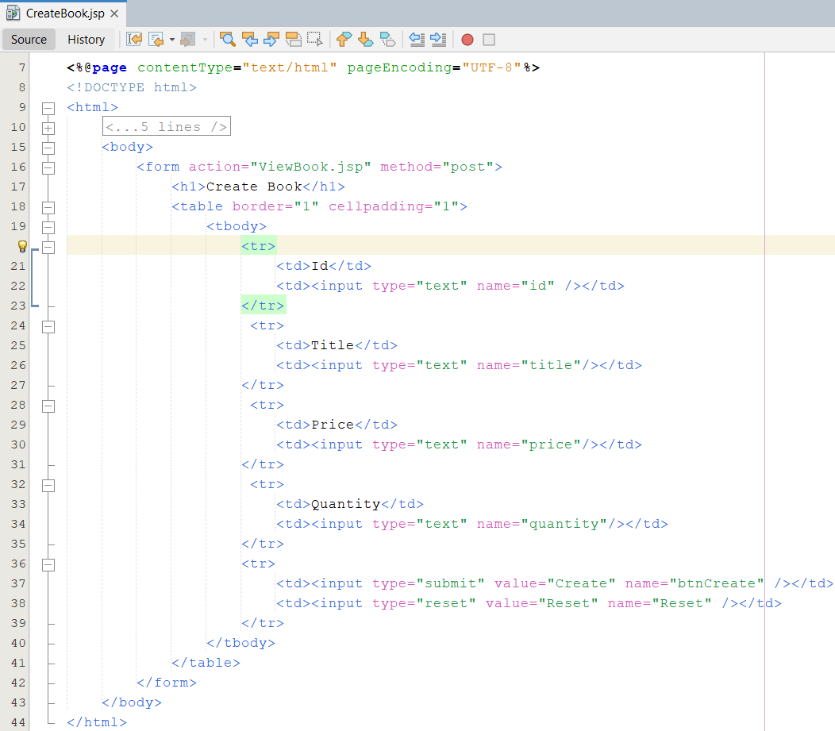
Demo 01
2

Slide 18
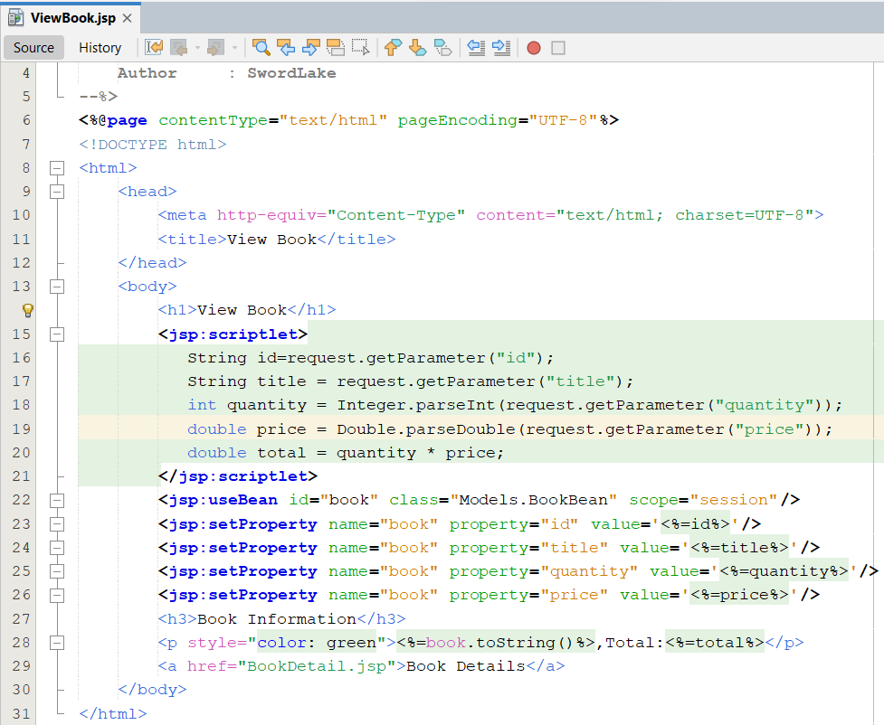
Demo 01
3

Slide 19
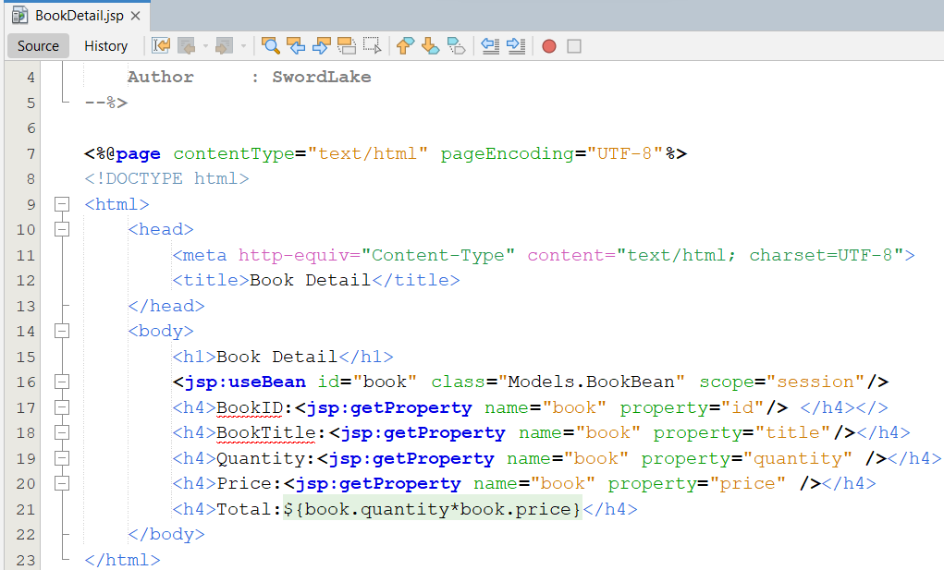
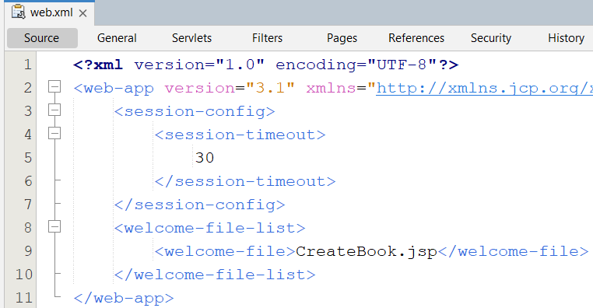
Demo 01
4
5

Slide 20
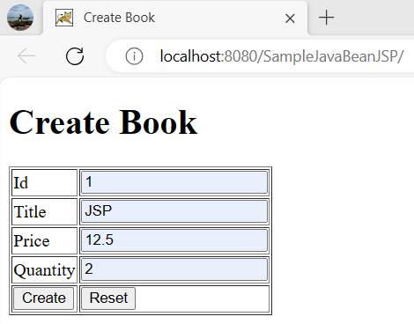
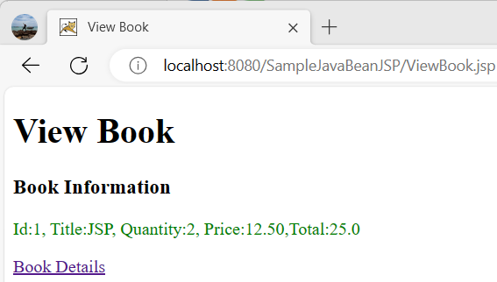
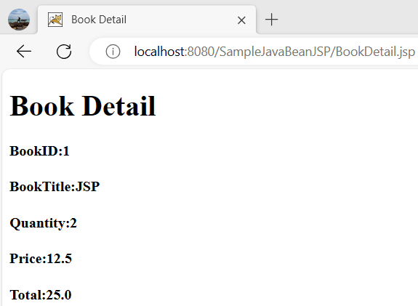
Demo 01
6
7
8

Slide 21
JSP Standard Actions Steps in design Web Application following MVC patterns
Step 1
create View
Step 2
Depends on View, determine some persistence controls that are implemented as the Java Bean (Model) ‘s properties
Implement the Java Bean with accessor methods and some utilitie methods that are used to query the properties of Java Bean
The methods are designed following the OO standard
Step 3
Create servlet (Controller)/JSP page combining View & Model

Slide 22
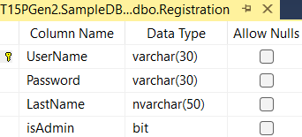
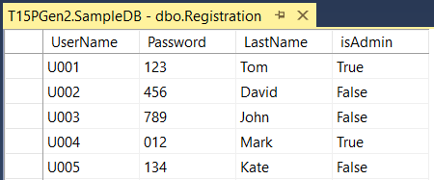
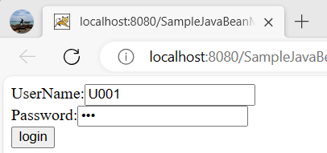
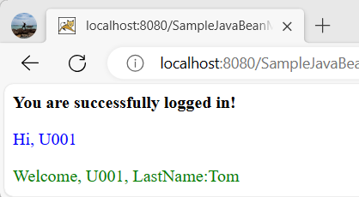
MVC Model 1
1
2

Slide 23
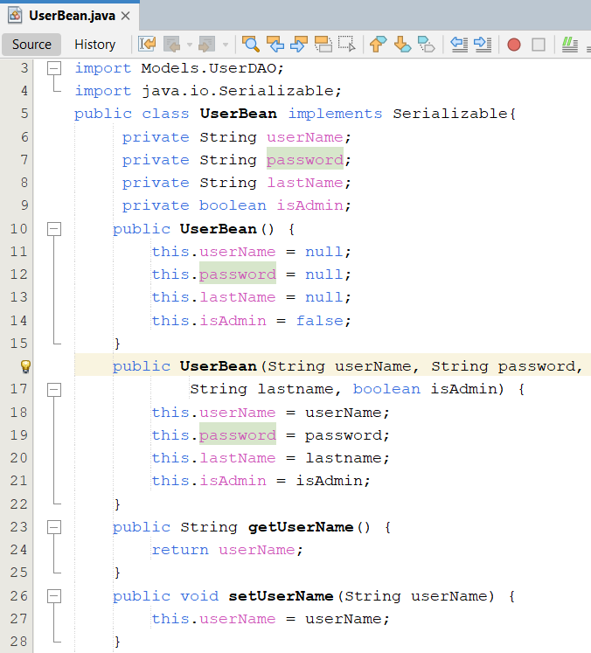
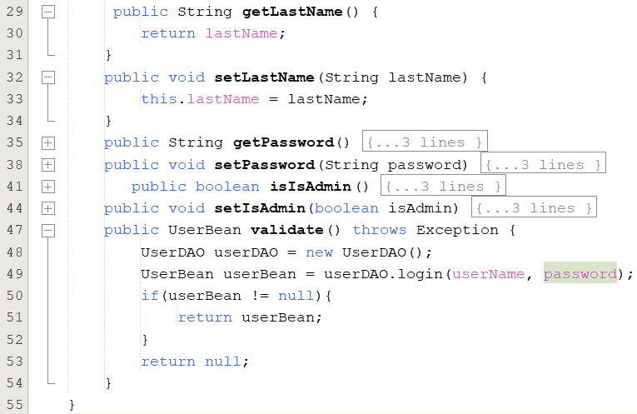
MVC Model 1
3

Slide 24
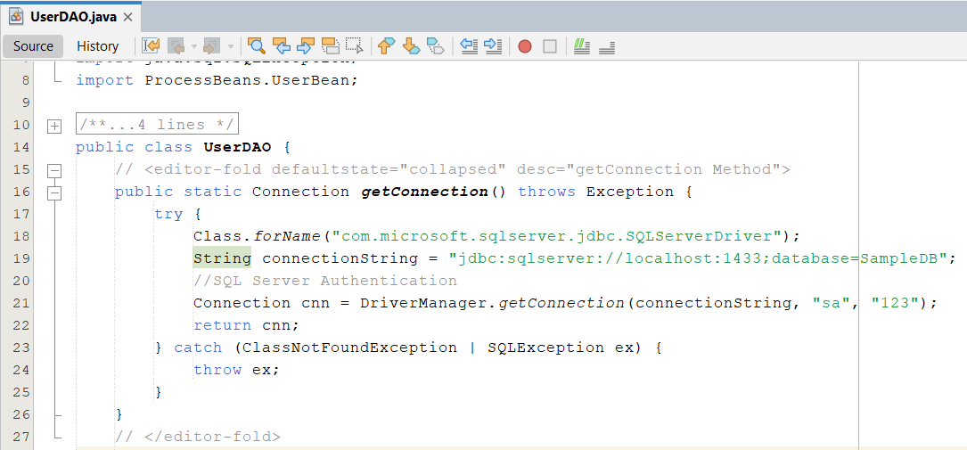
MVC Model 1
4

Slide 25
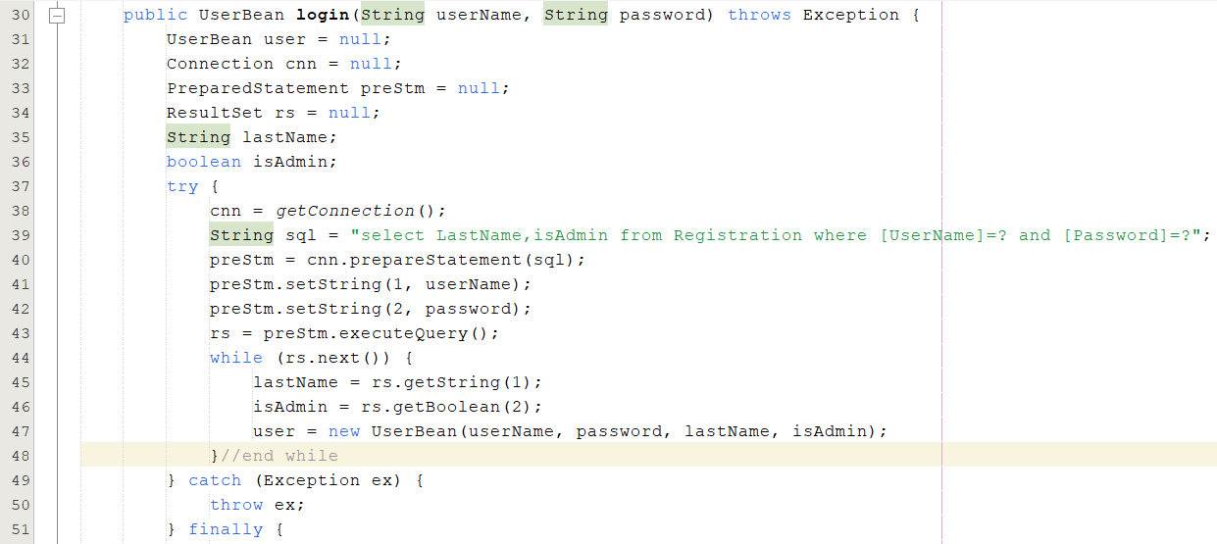
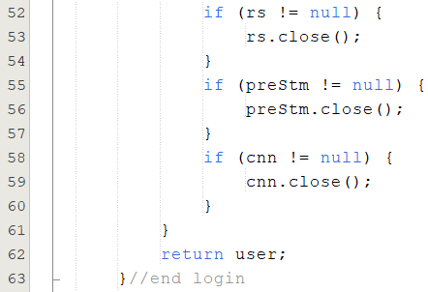
MVC Model 1

Slide 26
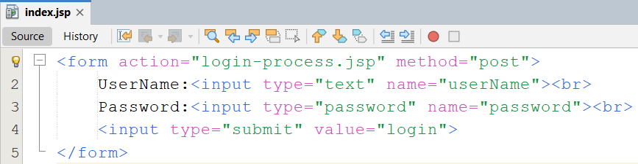
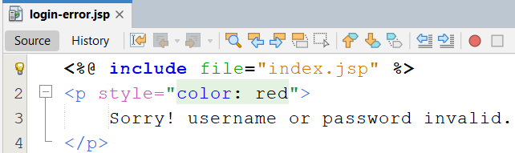
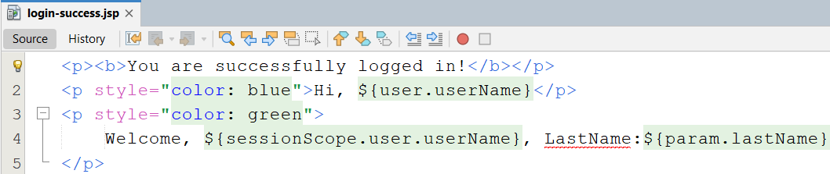
MVC Model 1
5
6
7

Slide 27
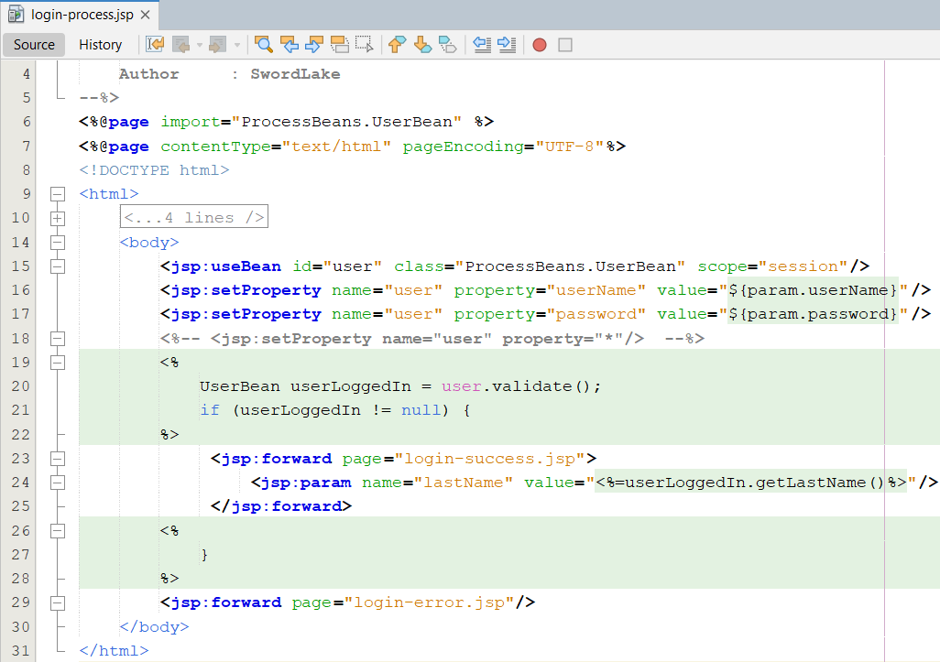
MVC Model 1
8

Slide 28
MVC Model 1
9
10

Slide 29
JSP Standard Actions Scope of JavaBeans
page
Accessible for current page. The life span tills the current page displayed
The information is stored in pageContext (get values through the getAttribute method) – default scope
application
Current and any successive request from the same Web Application. Global to all JSP and servlet.
The information is stored in ServletContext.
The life span is Application
session
The information is stored in HttpSession combined current request (get values through the getValues method of Session interface (Implicit Object)).
The life span tills the session destroyed, time out, or Web browser closed.
request
Accessible for current request (get values through the getAttribute methods)
The information is stored in ServletRequest
The life Span tills the request processed and the response is sent back to the Web browser

Slide 30
JSP Standard Actions Scope of JavaBeans
Notes:
Using JavaBeans with Session or Application scope, a JSP page must declare a tag action jsp:useBean with a same id and class name.
JSP, JSP/ Servlet engine defines scope in executing Web application, if the instance bean existed, the engine does not instantatiate new one (the tag jsp:useBean is omited) to execute Bean’s methods. Otherwise, the engine create a new instance.

Slide 31
Dispatching Mechanisms The <jsp:include> tag
Can be used to include the response from another file within the JSP page output.
To incorporate the content or insert a file from another page into current page
Syntax
<jsp:include page=“…” flush=“true” />
The file whose response should be included has to reside somewhere in your web application but doesn’t have to be present until the page is actually requested
Notes:
Incorporate : ket hop

Slide 32
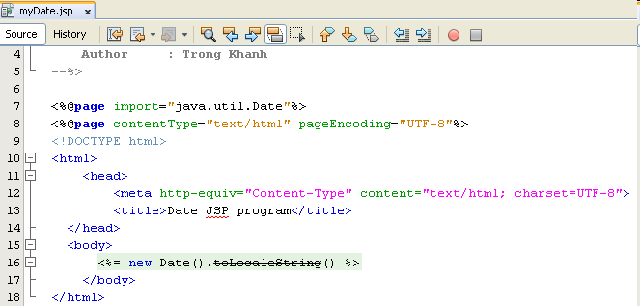
Dispatching Mechanisms The <jsp:include> tag – Example

Slide 33
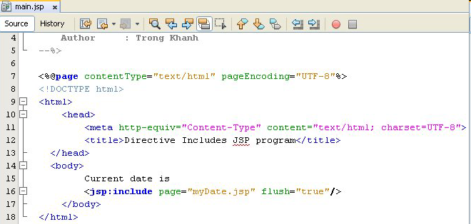
Dispatching Mechanisms The <jsp:include> tag – Example

Slide 34
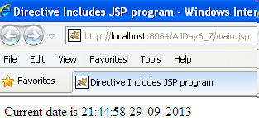
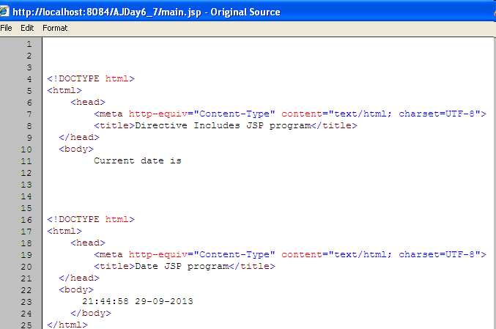
Dispatching Mechanisms The <jsp:include> tag – Example

Slide 35

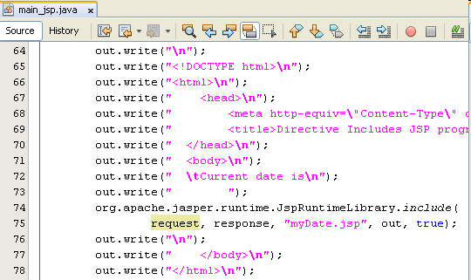
Dispatching Mechanisms The <jsp:include> tag – Example

Slide 36
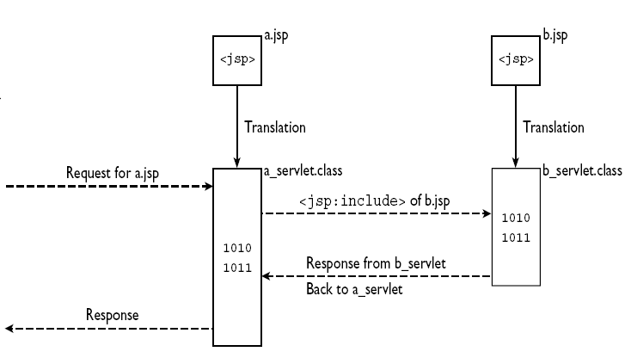
Dispatching Mechanisms <jsp:include> vs. <%@ include …%>
<jsp:include>

Slide 37
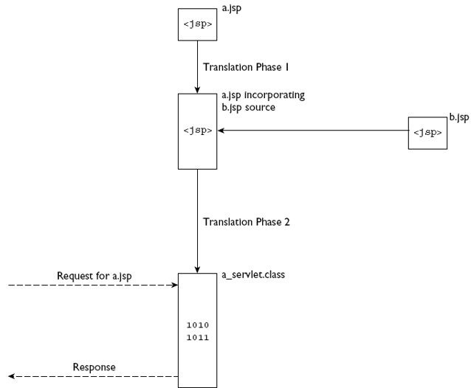
Dispatching Mechanisms <jsp:include> vs. <%@ include …%>
<%@ include %>

Slide 38
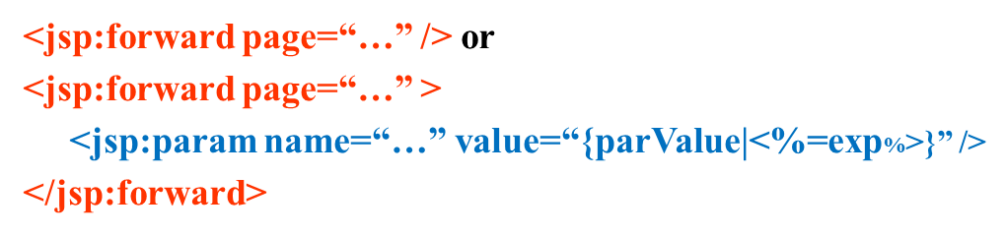
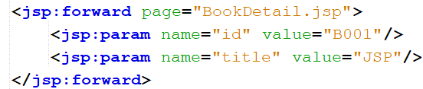
Dispatching Mechanisms The <jsp:forward> tag
Forwards processing to another resource within the web application
To permanently transfer control from a JSP page to another location on the local server
Is used to redirect the request object containing the client request from one JSP file to another file. The target file can be an HTML file, another JSP file or a servlet
The code after the <jsp:forward> element is not processed
Syntax

Slide 39
Expression Languages EL Language Basics
New feature of JSP 2.0
Allows JSP developers to access and manipulating java objects via a compact, easy-to-use shorthand style (similar to JavaScript)
It can handle both expressions and literals
Can be used to display the generated dynamic content in a table on the web page and can also be used in HTML tags
Developed by two groups
JSP Standard Tag Library expert group
JSP 2.0 expert group
Syntax: ${EL Expression}
JSP EL expressions are used in
Static text
Standard and Custom tags
Advantages
Clear syntax
Simple & robust
Easy access application data stored (in JavaBeans)
Notes:
-Compact : gọn nhẹ
-Expression Language (EL)

Slide 40
Expression Languages EL Operators
Operators
Arithmetic
Relational
Logical
Others
*
/ or div
+
-
% or mod
< or lt
> or gt
< = or le
> = or ge
= = or eq
!= or ne
&& or and
|| or or
! or not
true
false
empty
? :
null

Slide 41
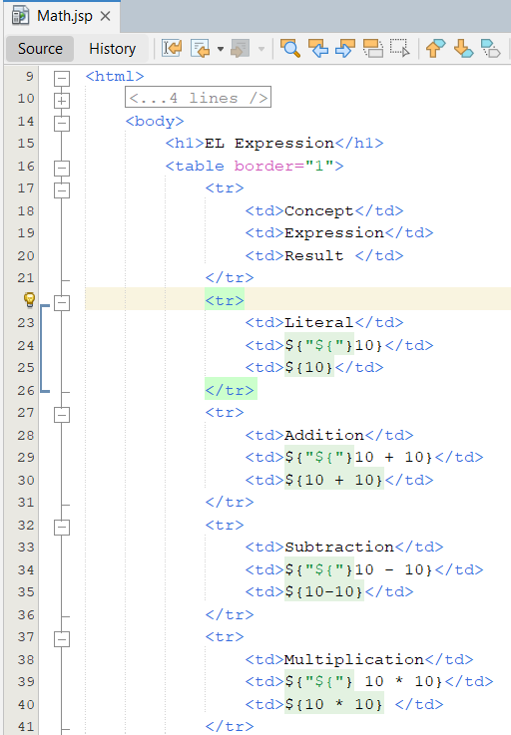
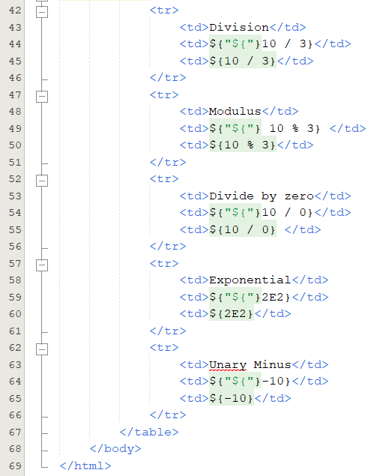
Expression Languages EL Operators – Example

Slide 42
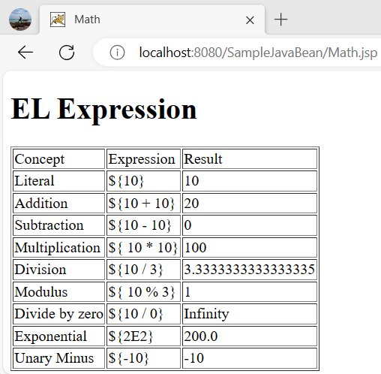
Expression Languages EL Operators – Example

Slide 43
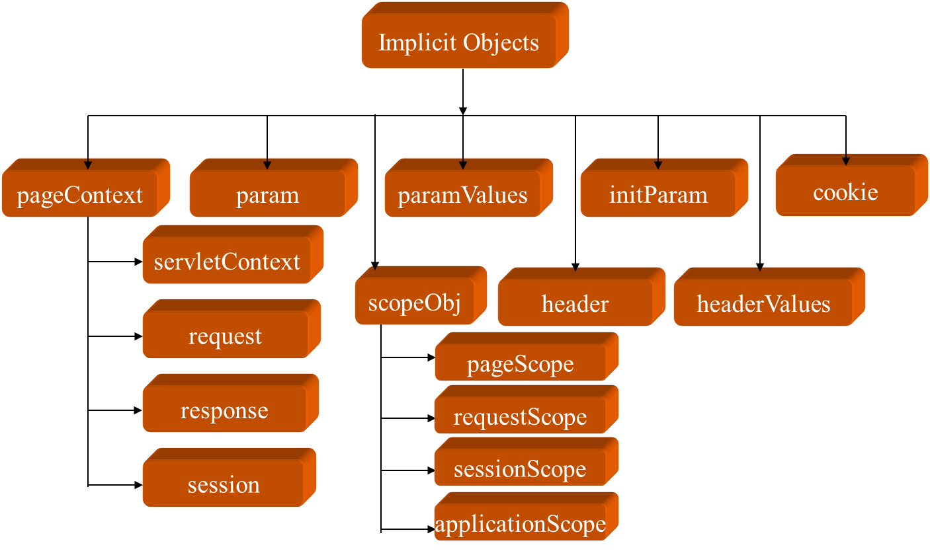
Expression Languages EL Implicit Objects
Are a standard set of classes.
The user creates an instance of an implicit object to use to use available methods and variables, that are provided by JSP container, through EL Expressions

Slide 44
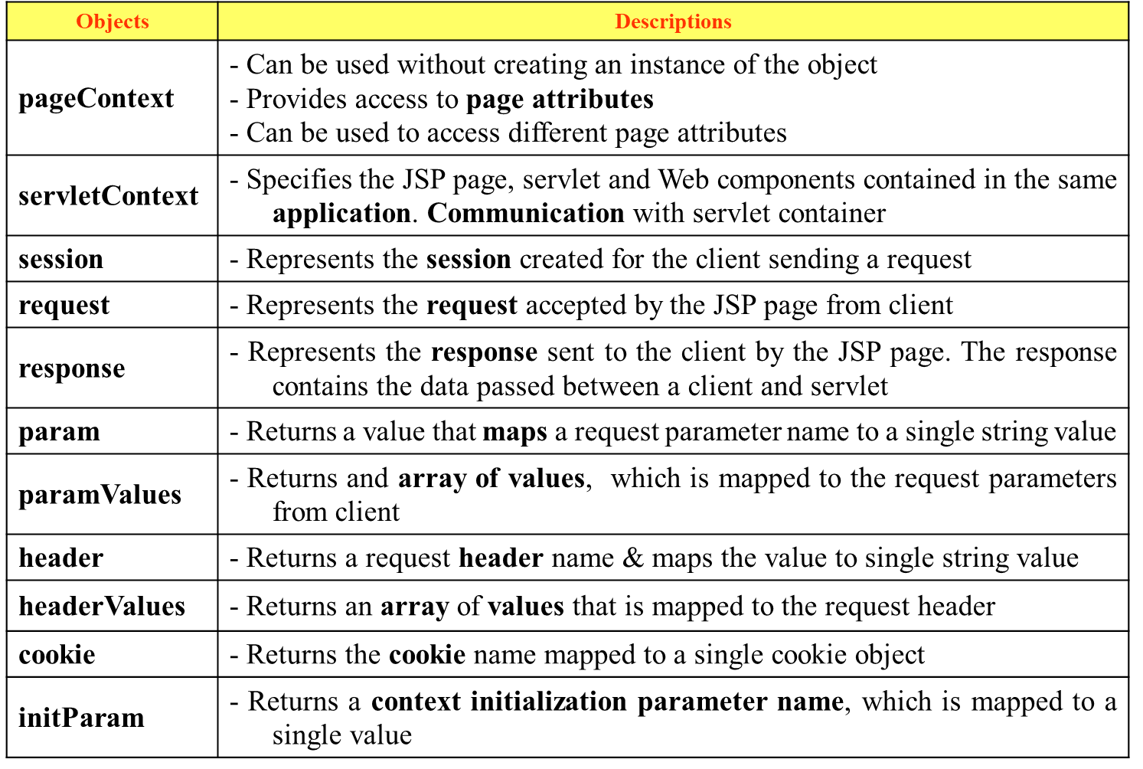
EL Implicit Objects

Slide 45
Expression Languages EL Implicit Objects
getParameter
${param.param_Name}
Similar to: request.getParameter(“param_Name”)
Get Properties in Java Beans
${bean_id.property_name} or ${bean_id[“property_name”]}
Similar to: <%= bean_id.getProperty_name %>
Or, <jsp:getProperty name=“bean_id” property=“prop_name”/>

Slide 46


Expression Languages Scoped Variables
Variables
Are used to store and access values in JSP program
Refers as a attributes that are stored in standard scope such as page, request, session and application
Ex: <% xxxContext.setAttribute(“name”, “value”) %>
${name} or ${xxxScope.name}
Dot operator “.” or square brackets [ ] can be used to access value of variable
The “.” and [] is used to display a property of java bean (getter method)
They are not limited one level
They support accessing the arrays, lists, and map element (e.g. a[i], list.get(i), map.getValue(key)
Ex : ${pageScope.color}
${pageScope[“color”]}
The term scoped variable means that the variable confined to the mentioned context only.
The EL enhances supporting the retrieval of the stored objects as scoped variables
Notes:
<% pageContext.setAttribute("count",10); %>
<% request.setAttribute("count",20); %>
<h4>${count}</h4>
<h4>${requestScope.count}</h4>
Output: 10 ( mặc định lấy att của Page)
20
-------------------
<% pageContext.setAttribute("count",10); %>
<% request.setAttribute("count",20); %>
<h4>${pageScope["count"]}</h4>
<h4>${requestScope.count}</h4>

Slide 47
Expression Languages Scoped Variables
Scopes | Descriptions
pageScope | - Returns page-scoped variable names, which are mapped to their values - Is accessible from the JSP page that creates the object
requestScope | - Provides access to the attributes of request object - Returns requests coped variable names, which are mapped to their values - Is accessible from web components handling a request that belongs to the session
sessionScope | - Returns session-scoped variable names, which are mapped to their values - Is accessible from Web components handling a request that belong to the session
applicationScope | - Returns application-scoped variable and maps the variable name to their values

Slide 48
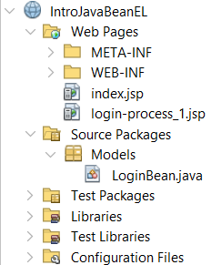
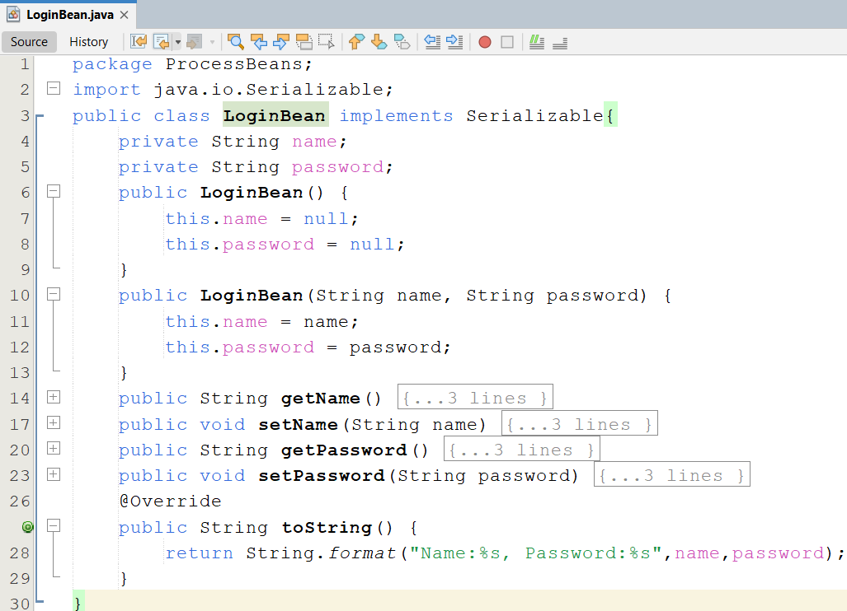
Expression Languages Example 01
1

Slide 49
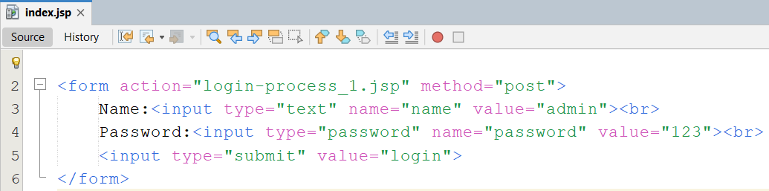
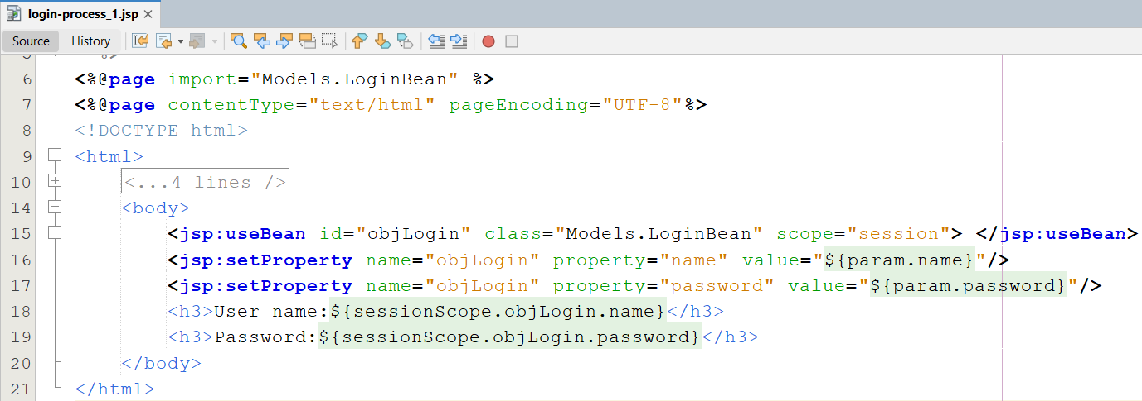
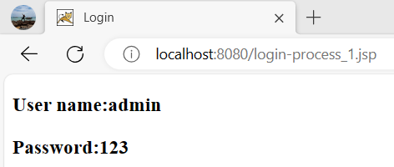
Expression Languages Example 01
2
3

Slide 50
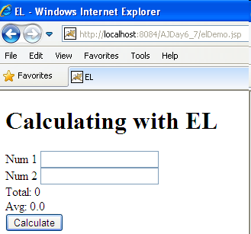
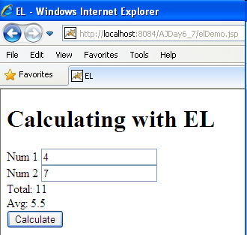
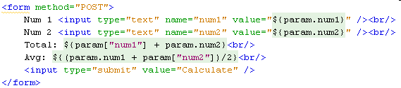
Expression Languages Example 02

Slide 51
Lab
1

Slide 52
Lab
2

Slide 53
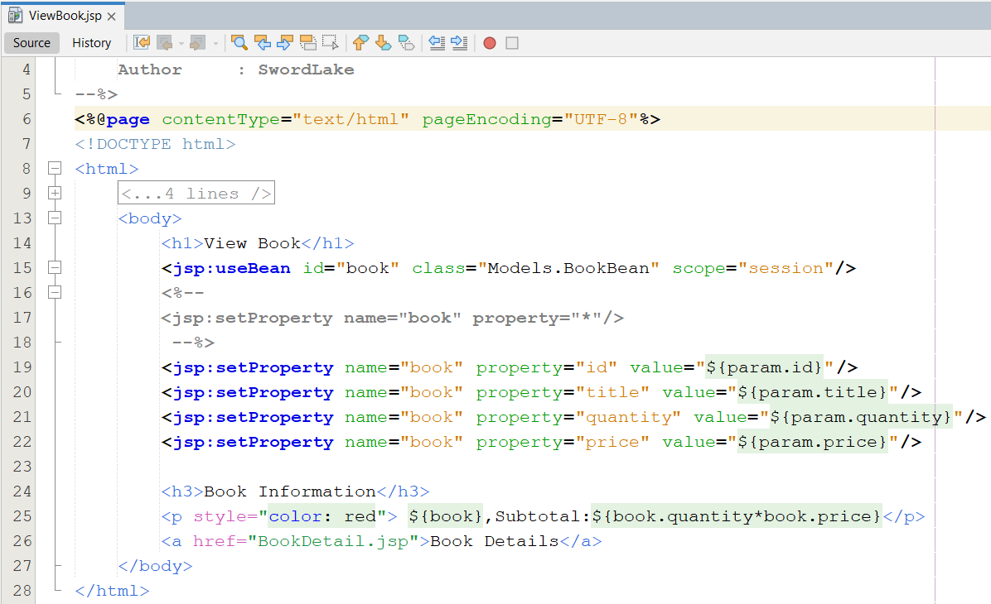
Lab
3

Slide 54

Lab
4
5

Slide 55


Lab

Slide 56
Summary
How to build the Web Application using MVC1? How to remove the java code in the jsp (view)?
Standard Actions
Dispatching Mechanisms
Expression Language
Q&A

Slide 57
Next Lecture
How to remove completed Scripting Element (Java Code) in JSP (View)? Complete the View of MVC 2 Design Pattern
JSTL
How to build the data grid tag library using in JSP?
Tag Libraries
Model
Classical, Simple, and Handles
How to implement the custom Tag Lib and use it in JSP

Slide 58
Appendix XML for JSPs
HTML is narrowly focused on marking up take
XML can be defined by users and can used for making up text (as in XHTML), but it has a pretty much infinite set of the other possible uses
The tag in jsp has
Opening tag
Closing tag
Data content between the opening and closing tags (called as the body)
The opening tag can have a prefix and can contain many attributes
Contain the nested tag

Slide 59
Appendix XML-Friendly Syntax
JSP documents
Are JSP source files written entirely in XML syntax
Have a .jspx extension
Can be also be identified by setting in web deployment descriptor
<jsp-config>
<jsp-property-group>
<url-pattern>/jspx/*</url-pattern>
<is-xml>true</is-xml>
</jsp-property-group>
</jsp-config>
Or, Define in a JSP document as form
<jsp:root xmlns:jsp=“http://java.sun.com/JSP/Page”>

Slide 60
Appendix XML-Friendly Syntax
JSP document syntax provides replacements for all <%-type scripting element syntax
<jsp:scriptlet>…</jsp:scriptlet> replace <%...%>
<jsp:expression>…</jsp:expression> replace <%= … %>
<jsp:declaration>…</jsp:declaration> replace <%! … %>
<jsp:directive.page …/> replace <%@page ...%>
<jsp:directive.include …/> replace <%@ include …%>
<!-- … --> replace <%-- … --%>
There are some things within the Java language itself that are anathema to XML validators (ex: “<“ symbol looks like the beginning of an opening or closing tag, and an XML validator will assuredly treat it as such)
Using as an entity in XML that begin with an ampersand (&) and end on a semicolon (;). Ex: &lt;
Using <![CDATA[symbol]]> or <![CDATA[command]]>
Ex: <![CDATA[for(int i=0; i<10; i++)]]> or i <![CDATA[<]]> 10

Slide 61

Appendix XML-Friendly Syntax

Slide 62


Appendix XML-Friendly Syntax – Sample

Slide 63



Appendix XML-Friendly Syntax – Sample

Slide 64
Appendix Functions using EL
Supports using of the Java function within the JSP page is an easy as using a tag
The following steps to set up EL to Java functions
Step 1: Creating “static” method
Step 2: Creating Tag Library Descriptor
Step 3: Modifying Deployment Descriptor and locating the TLD file in web deployment descriptor (if necessary)
Step 4: Access EL functions within JSP

Slide 65


Appendix Creating “static” method
The static java methods can be called within the EL expression
Ex:

Slide 66
Appendix Creating Tag Library Descriptor
After defining the functions, the function name should be mapped with EL using a Tag Library Descriptor (TLD) file
A defined in a class with EL. TLD file uses XML syntax to map the name of functions
Save this TLD file in the /WEB-INF/tlds folder, where tlds is a user-created folder
<?xml version="1.0" encoding="UTF-8"?>
<taglib version="2.0" xmlns="http://java.sun.com/xml/ns/j2ee" xmlns:xsi="http://www.w3.org/2001/XMLSchema-instance" xsi:schemaLocation="http://java.sun.com/xml/ns/j2ee web-jsptaglibrary_2_0.xsd">
<tlib-version>1.0</tlib-version>
<function>
<description>information description</description>
<name>functionName</name>
<function-class>Java class</function-class>
<function-signature>declared method with parameters</function-signature>
</function>
</taglib>

Slide 67

Appendix Creating Tag Library Descriptor
Click Next button

Slide 68

Appendix Creating Tag Library Descriptor
Fill taglib name
Browse to directory containing taglib. Should not be changed
Click Finish button
The taglig file with extension is tld located at the WEB-INF/tlds directory

Slide 69

Appendix Creating Tag Library Descriptor
Modified the .tld file

Slide 70
Appendix Modifying the Deployment Descriptor
The default mode for JSP pages delivered with JSP version 2.0 technology is to evaluate EL expressions
JSP EL expression can be enabled or disabled with 02 ways
Using isELIgnored attribute in the JSP page directive
<%@ page isELIgnored= “true | false” %>
Modifing in web.xml
<jsp-config>
<jsp-property-group>
<url-pattern>*.jsp</url-pattern>
<el-ignored>false</el-ignored>
</jsp-property-group>
</jsp-config>

Slide 71
Appendix Accessing EL functions within JSP
To access the function created in a TLD file using a JSP file, developer need to import the TLD file using the taglib directive. In the directive statement, developer need to mention a prefix for the tags and location of the TLD file
<%@taglib prefix=“prefix” uri=“path” %>
After importing the TLD file, developer can access the function using an EL expression
${prefix:funcName(args)}

Slide 72


Appendix Example

Slide 73

Appendix Coersion
Means that the parameters are converted to the appropriate objects or primitives automatically
EL defines appropriate conversion with default values
For example, a string parameter from a request will be coerced to the appropriate object or primitive.
There is a difference between type coercion and type conversion.
Coercion is implicit type conversion and its usually performed automatically by the compiler
Type conversion is an explicit type conversion inserted by the programmer.

Slide 74
Appendix Coersion
Boxing an Unboxing
Boxing converts values of primitive type to corresponding values of reference type.
If i is a boolean value, then boxing conversion converts i into a reference r or class and type Boolean, such that r.value() = i.
If i is a byte value, then boxing conversion converts i info a reference r of class and type Byte, such that r.value() = i
Unboxing converts values of reference type to corresponding values of primitive type
If r is a Boolean reference, then unboxing conversion converts r into v of type boolean, such that r.value() = v.
If r is a Byte reference, then unboxing convertion converts r into a value v of type byte, such that r.value() = v.
Coercion to String
A is String, return A
A is null, return “”
A.toString() throws exception, return error. Otherwise return A.toString()

Slide 75
Appendix Coersion
Coercion to Number
The rule to coerce a value to number type are If A is null or “”, return 0
A is character and is converted to short, developer apply following rules:
If A is Boolean, return error
If A is number type, return A
A is number, coerce occurs quietly to type N using the following algorithm:
If N is BigInteger
If A is BigDecimal, return A.toBigInteger()
Otherwise, return BigInteger.valueOf(A.longValue())
If N is BigDecimal
If A is a BigInteger, return new BigDecimal(A)
Otherwise, return new BigDecimal (A.doubleValue())
If N is Byte, return new Byte (A.byteValue())
If N is Short, return new Short (A.shortValue())
If N is Integer, return new Integer(A.integerValue())
If N is Long, return new Long(A.longValue())
If N is Float, return new Float(A.floatValue())
If N is Double, return new Double(A.doubleValue())
Otherwise return error

Slide 76



Appendix Coersion – Example

Slide 77

Appendix Coersion
Notes:
Variables declared in JSP page (in scriptlet or declaration) cannot be accessed in JSP page or all of them can be presented with ${variable_name}
Therefore, if these variables are forced in expression with EL, the value of these variables are converted to 0 (number) or false (boolean)
The EL operators’ arithmetic or logical is only applied to arithmetic or logic. If the value is not same type, the exception is thrown
The EL can access the attribute in particular scope (page, request, session, application)
The coersion is applied on the used operator in expression

Slide 78


Appendix Coersion – Example

Slide 79

Appendix Coersion – Example

Slide 80

Appendix Coersion – Example

Slide 81

Appendix Coersion – Example

